Slide 1

Paycheck Protection Program
Ramith Wijesinghe
IC22046

Slide 2

What is PPP?
The Paycheck Protection Program is an $800 Billion business loan program established by the United states federal government. This program was meant to protect small businesses as well as large corporations.
https://smallbizclub.com/wp-content/uploads/2018/06/How-to-Read-a-Paycheck.jpg

Slide 3


Data Sets Provided
PPP Applicants Full
This is the full data sets of the PPP applicants which was approved, and which had received the loans.
PPP Removed
This is the data set of the applicants who was removed due to reasons being self withdraw, Information problems with the lenders and Fraud.

Slide 4
Q1:What are some defining characteristics of the removed loans?
Forgiven Amount.
Loan amount and Undispersed Loans.
Terms of the Loans.
Business type.
Jobs retained.
NAICS numbers.

Slide 5
Q2:How do the characteristics of loans that were removed from the PPP data compare to loans that were not removed from the PPP data?
The relationship between the loan amount and Undispersed Loans is significantly different.
Many of the removed loans vary from 24 to 60 terms while the ones that was not removed vary from 5 to 60. This means the removed loans were never below 24. The removed ones was maybe in financial peril.
In the removed loans, there was no forgiveness amount. This could mean that the loans were never issued, or the people ran off with the money.
The cities of the loan receiver and lender are important.

Slide 6

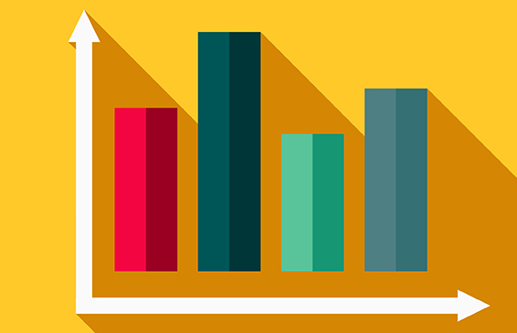
Graphs & Stats

Slide 7
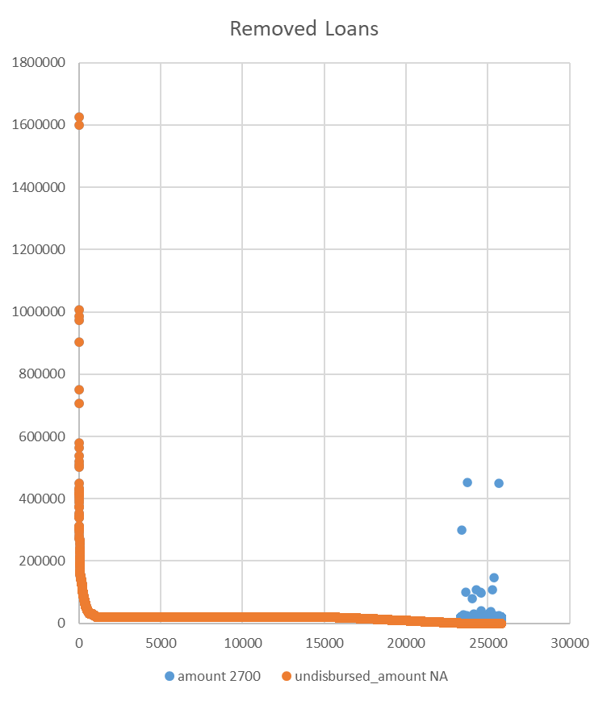
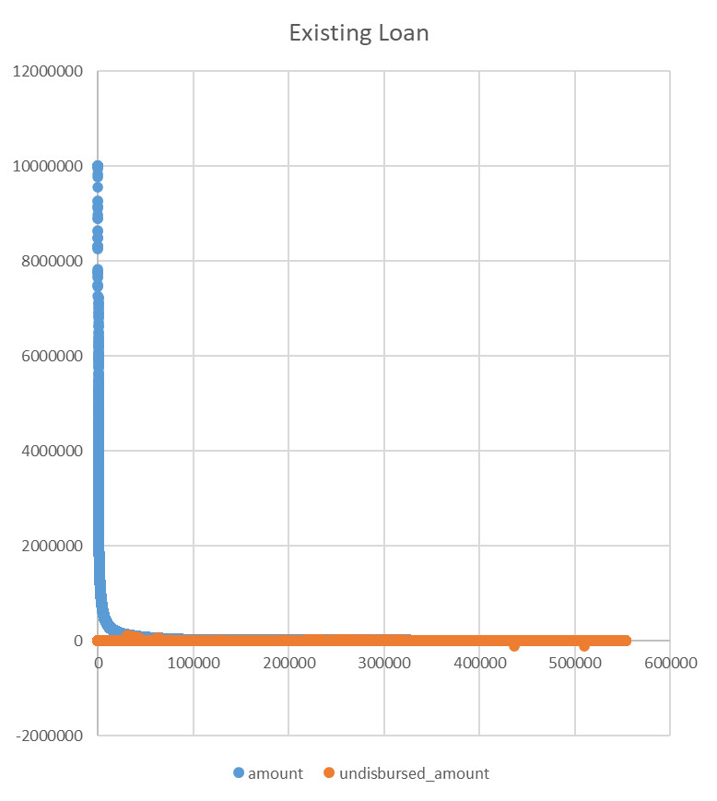

Slide 8
Q3:3. Is it possible to accurately predict whether or not a loan was removed from the data, using fields in the data set and/or additional information you incorporate?
To a certain extent of accuracy, it is possible. By using the defining characteristics of each different data sets we can make predictions on what kind of loans would be suitable for removal.
Additional information like demographic, location background, etc.. Would also be helpful in getting more accurate predictions.

Slide 9

Conclusion
Through this data analysis project, I got to understand how the PPP loans were structured and how to identify the loans which should be removed.
It also paved way in understanding about Data analysis a bit more.

Slide 10
Thank you

